Slide 1
Interview Question What is ArrayStoreException in java?
momedaram

Slide 2
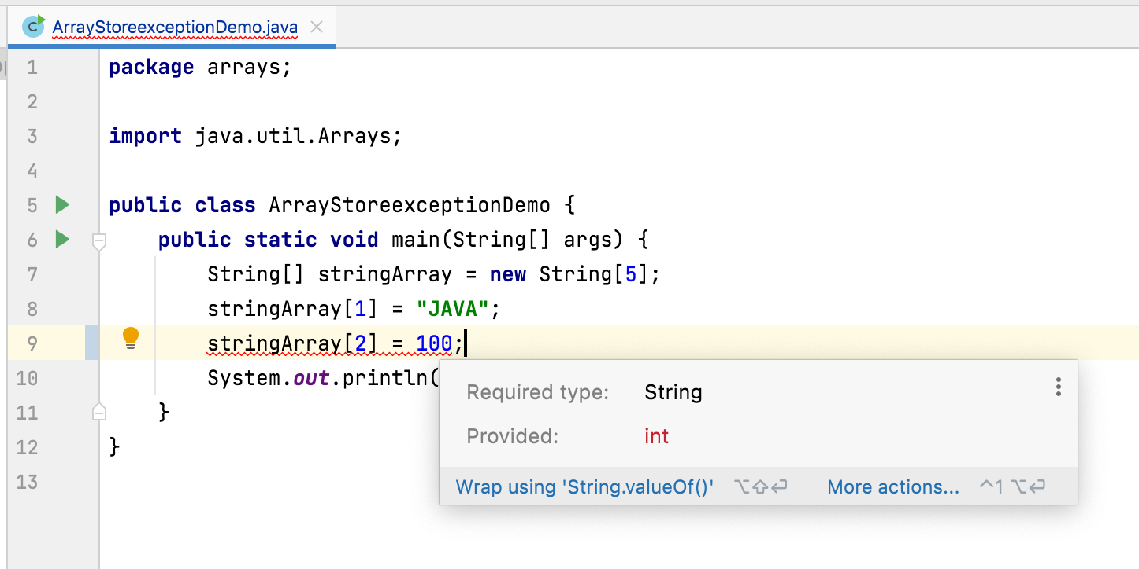
ArrayStoreException is a run time exception.
Which occurs when we try to store non-compatible element in an array object.
For example, we can store only string elements in an array of strings. if we try to insert integer element in an array of strings, we will get ArrayStoreException at run time.

Slide 3
